Slide 1
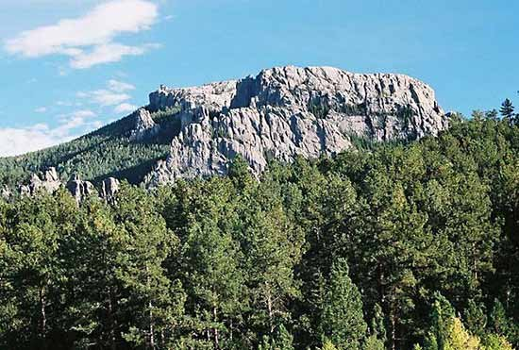
Initial Deposits in the Cordilleran Geosyncline: Evidence of a Late Precambrian (<850 m.y.) Continental Separation
Stewart, J.H., 1972. Initial deposits in the cordilleran geosyncline; Evidence of a late Precambrian (<850 m.y.) continental separation. Geological Society of American Bulletin, 83: 1345-1360

Slide 2
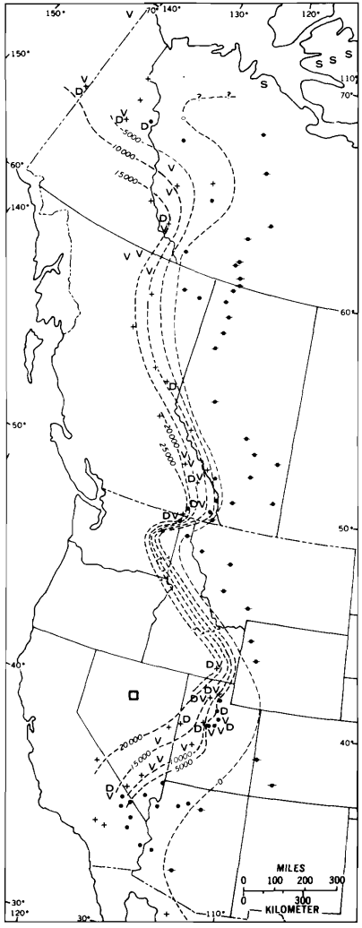
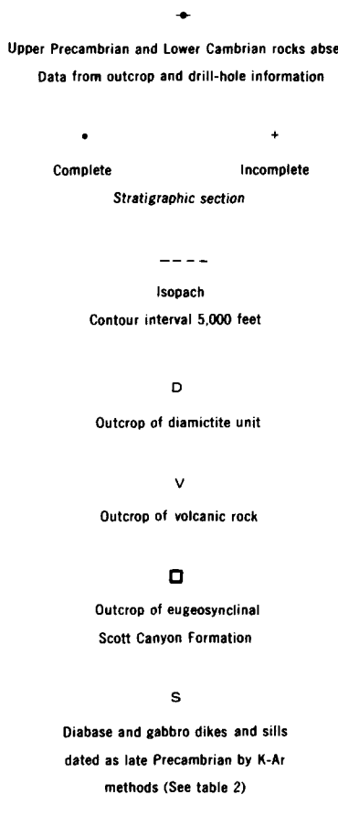
Introduction
Purpose:
To suggest there was a change in the tectonics in western North America that marked the beginning of the Cordilleran geosyncline
Four main ideas:
Sedimentary sequences form on continental margins after separation
Continental separation causes cutting of older structures
Base unit of the Cordilleran geosyncline was diamictite
Volcanic activity was related to the thinning of crust during crustal separation
2 major sequences:
Belt Supergroup
- 850 to 1250 m.y.
Windermere Group
- <850 m.y.
- Upper Precambrian and Lower Cambrian of the Windermere cannot be separated

Slide 3
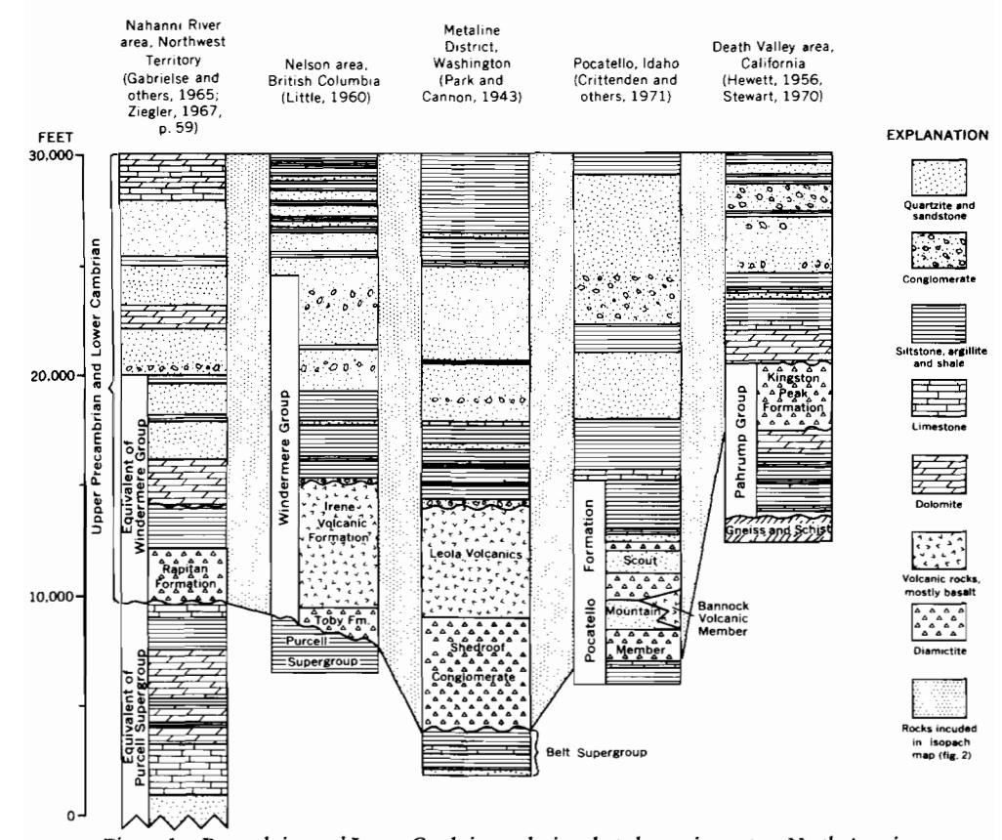
Detrital Rocks
Upper Precambrian and Lower Cambrian consist of:
the Windermere Group
Overlying Lower Cambrian rocks
Primarily composed of siltstone, argillite, shale, and conglomeratic quartzite
Limestone and dolomite are mixed in
Diamictite is the most important unit
Widely distributed and discontinuous
Glacial origins

Slide 4
Volcanic Rocks
Basaltic rocks are thick and widespread near the base of the sequence
Sparse in the upper portion
Petrographic and chemical characteristics are less well-known
Original minerals destroyed by alteration and metamorphism
High contents of CO₂ and H₂O
Upper Precambrian and Lower Cambrian rocks are similar to Tholeiitic basalts
Low alkali and Fe₃O₂/FeO

Slide 5
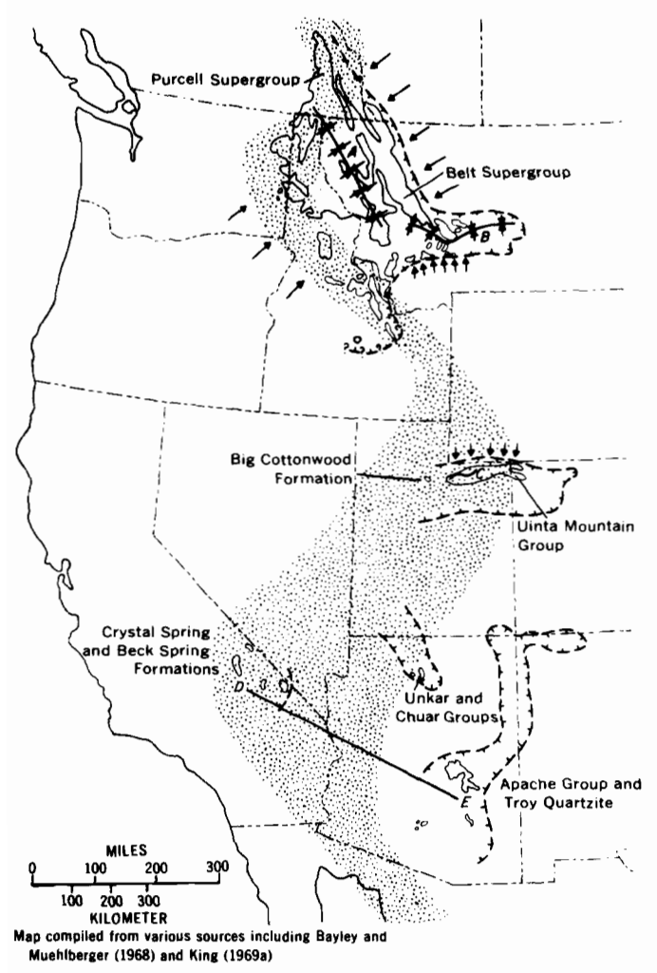
Underlying Strata
Upper Precambrian and Lower Cambrian sequence was deposited after an orogenic event
Occur in a narrow, slightly sinuous belt
Unconformities separates rocks of the Purcell and Belt Supergroup from the Windermere Group
- Belt supergroup deposited in a W-NW trough
In Utah,
Big Cottonwood Formation and the Uinta Mountain Group
East to west belt against north to south sequence trends
In California,
Crystal Spring Formation and the Beck Spring Dolomite
Lithologically similar to the Apache Group ~300 miles away
Suggests the tectonic setting of western North America changed before N-S sequence

Slide 6
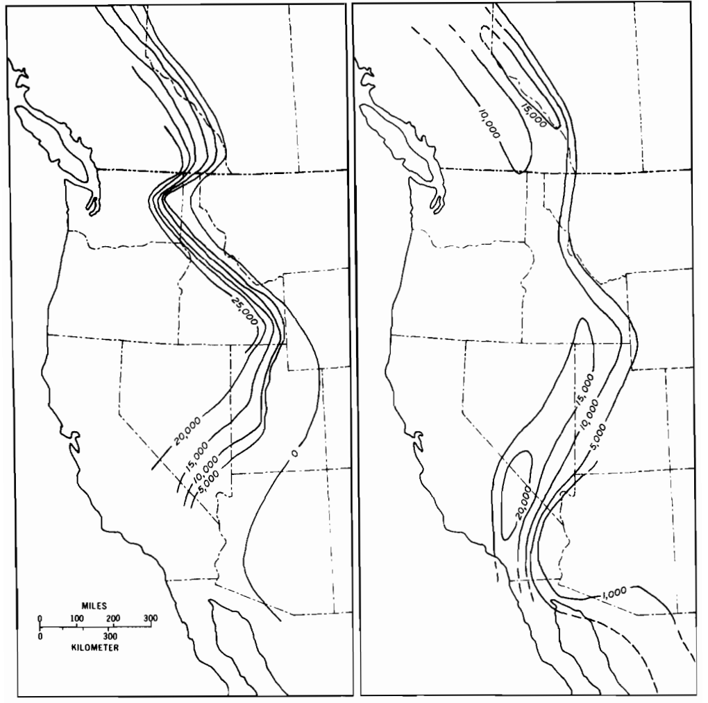
Overlying Strata
Upper Precambrian and Lower Cambrian rocks are overlain by lower Paleozoic carbonates and shales
Strata of the Cordilleran geosyncline
Depositional patterns between the two are similar
- Shown in the isopach maps
“Wasatch line” of Utah
Greatest thickening of of Paleozoic and Mesozoic strata
Coincides with the Precambrian and Lower Cambrian strata
Precambrian and Lower Cambrian rocks
Cambrian, Ordovician, and Silurian rocks

Slide 7
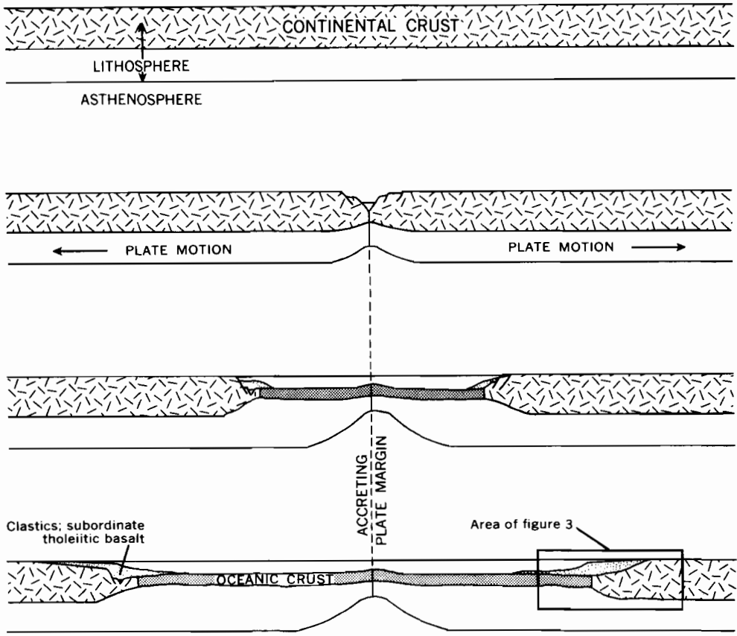
Late Precambrian Continental Separation
Origin of geosynclines
After continents separate, thick belts of sediment form linearly along the trailing edge
Tholeiitic basalts are extruded in area of thinning and rifting
Initial phases of separation
A likely explanation for the Cordilleran geosyncline
N to S trends of strata cuts across multiple troughs of different formations
Suggests a separation that occurred perpendicular to prior structures
Presence of tholeiitic basalts suggests there was volcanic activity related to the thinning and rifting of the crust

Slide 8
Summary
The Cordilleran geosyncline began due to continental separation
Younger than 850 m.y. but older than 570 m.y.
Two main sequences in Western North America
The Belt Supergroup (lower sequence)
850 to 1250 m.y.
The Windermere Group and younger strata (upper sequence)
<850 m.y.
Occurs in a narrow, sinuous belt from Alaska to Mexico
Units cannot be separated from Lower Cambrian strata in the Western U.S.
A change in the tectonic setting occurred before the deposition of the upper sequence
Strata of the upper sequence intercepting troughs of the Belt Supergroup and older units.

